Slide 1


Free Topics
Feb 23, 2023
CONTACT
Electrical Engineering
1st Engineering Building Room 201
Tel. +82 52 217 3542 Web. http://eche.unist.ac.krAddress

Slide 2

Lidar & Camera Fusion
Problem
Lidar – Difficulty in object recognition
Camera – Difficulty to recognize objects in weather such as rain and snow or nighttime
Solution
The fusion of Lidar and Camera compensates for each other’s weakness
Making high scored 3D cuboid by deep learning system
Complement each other when objects are difficult to determine due to a particular environment

Slide 3
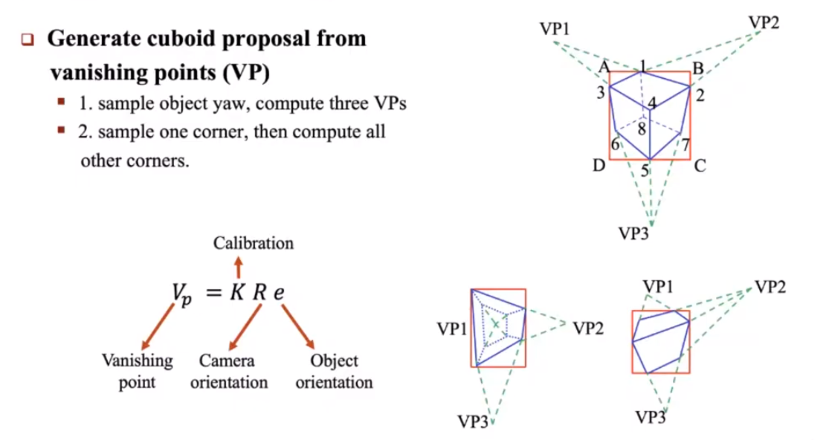
Lidar & Camera Fusion

Slide 4
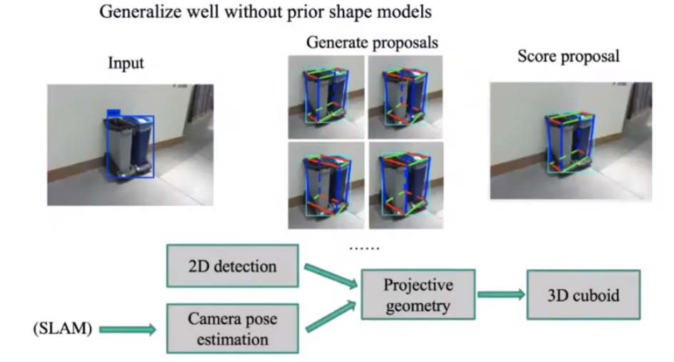
Lidar & Camera Fusion

Slide 5
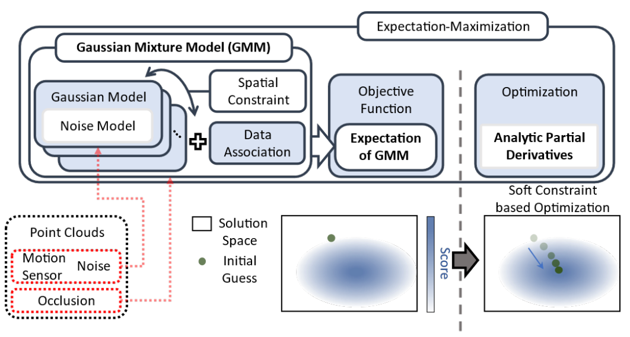
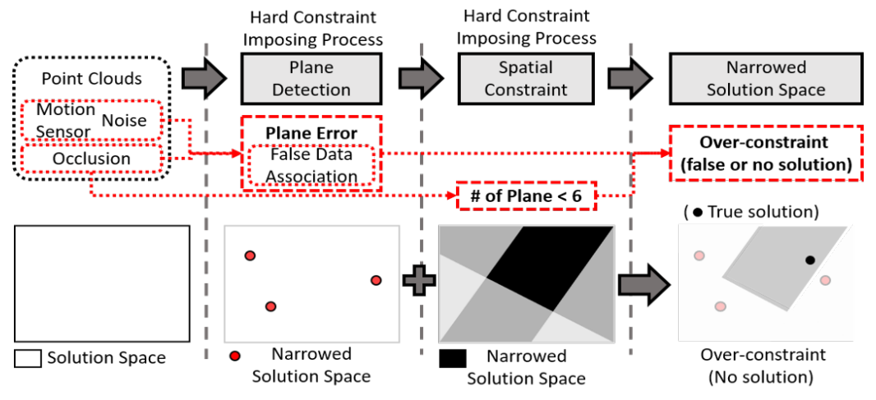
Lidar & Camera Fusion
“Robust Cuboid Modeling from Noisy and Incomplete 3D Point Clouds Using Gaussian Mixture Model”

Slide 6
Lidar & Camera Fusion
Making high scored 3D cuboid by deep learning system
<Camera Sensor>
2D Image
3D cuboid
Camera pose estimation
Scoring deep learning system
Slam
Real 3D cuboid detection
<Lidar Sensor>
Lidar pose estimation
3D cuboid
3D point Cloud

Slide 7
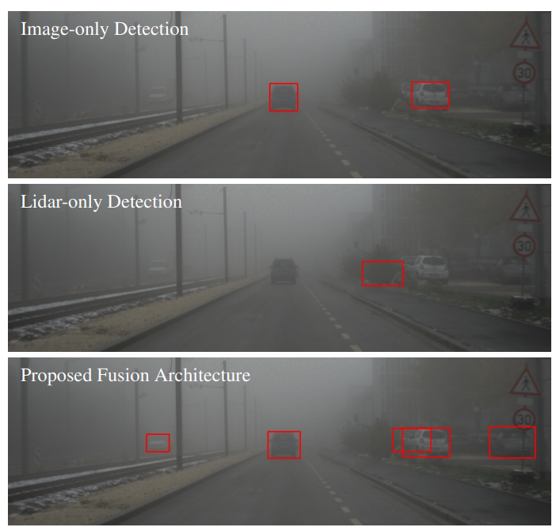
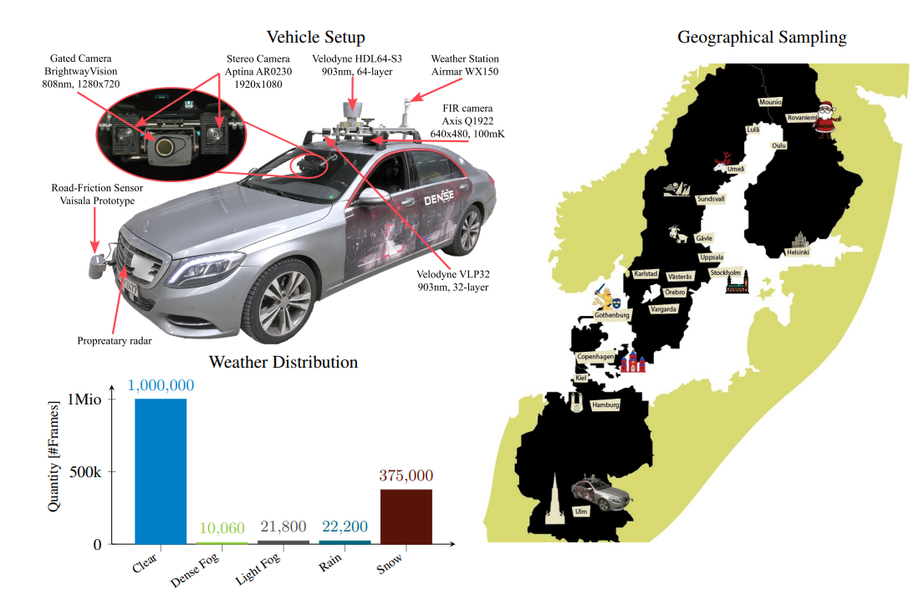
Lidar & Camera Fusion
“Seeing Through Fog Without Seeing Fog: Deep Multimodal Sensor Fusion in Unseen Adverse Weather”

Slide 8
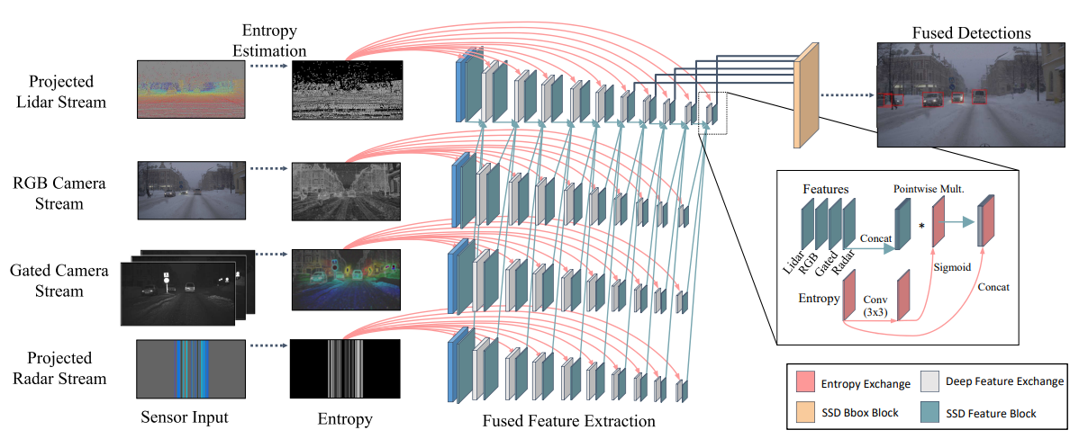
Lidar & Camera Fusion

Slide 9
Lidar & Camera Fusion
Complement each other when objects are difficult to determine due to a particular environment
<RGB Camera>
2D Image
3D cuboid
2D Image
3D cuboid
<Gated Camera >
Slam
Scoring deep learning system
Sensor pose estimation
Real 3D cuboid detection
3D point Cloud
3D cuboid
<Lidar>
3D point Cloud
3D cuboid
<Radar>

Slide 10
https://www.youtube.com/watch?v=l20TptB53RE

Slide 11
THANK YOU

